Slide 1
Knowledge Centre & Predictive Solution
Author: Pradeep Singh/Pritish Pattanaik

Slide 2
Objective
No touch- automate recurring issues solution by 30+%
For example, someone may submit a ticket describing an issue they’re having with getting VPN access. JIRA/OTRS/Remedy Service Desk will read the ticket and automatically suggest any knowledge base articles that relate to the ticket keywords. Then, the agent could send this article to the person who raised the issue, and they may be able to resolve it easily:
By Machine Learning mechanism process can be automated and with predicted solution.

Slide 3

Architecture
article history
Ticket
Article
Ticket history
ETL/Parser/Data Mining
ML ALGORITHM
Knowledge Base
INCIDENT
Service Request

Slide 4
Why we need Predictive solution and KB
Having a knowledge-centered service desk allows teams to respond and resolve issues quickly, provide consistent answers, and enable self-service.
Predictive Analysis
Predictive categorization
Event Prediction

Slide 5
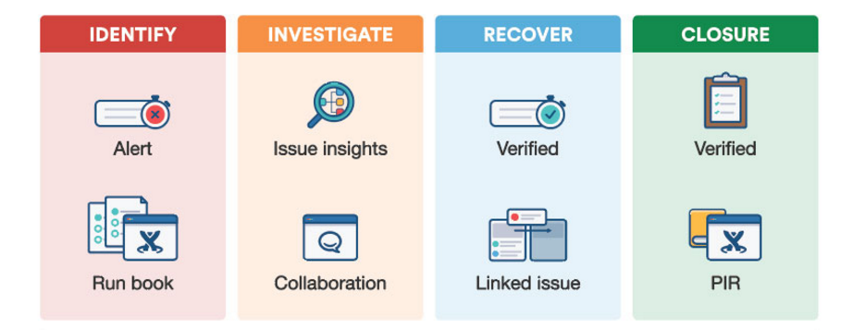
Identify, investigate, recover using Machine learning and Data Mining

Slide 6
Benefits
Decrease manual process and work flow
Faster restoration of service and issue
Presentation of optimal workarounds and solutions
Prevention of workarounds that cause other incidents
Reduced amount of double work for IT agents

